Slide 1
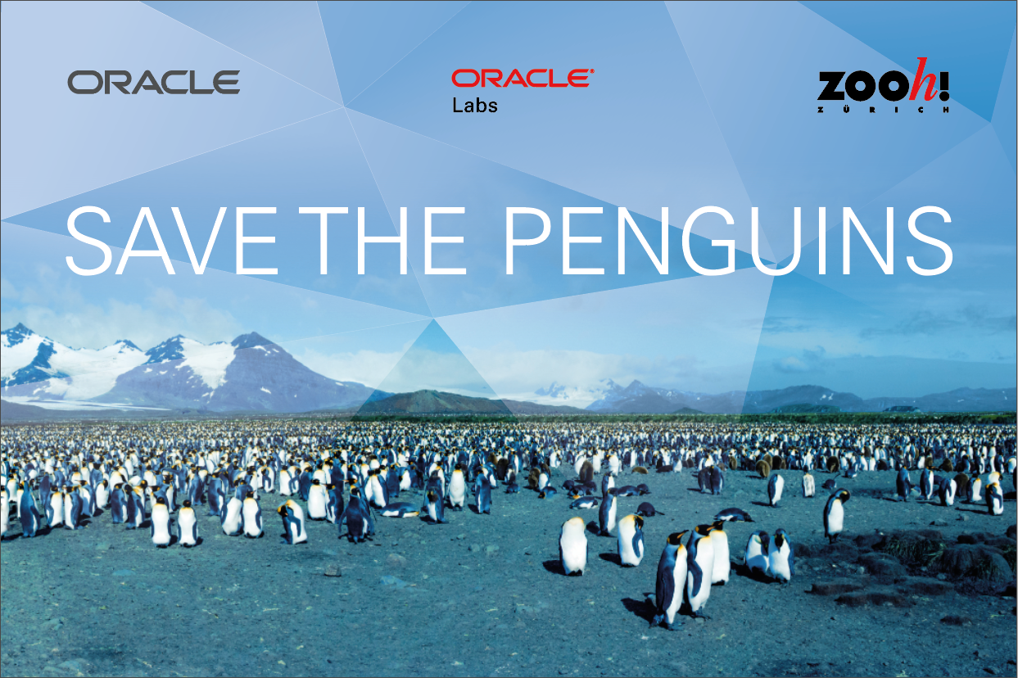
Title slide with picture border
Subtitle
Presenter’s Name
Presenter’s Title
Organization, Division or Business Unit
Month 00, 2019

Slide 2
Safe harbor statement
The following is intended to outline our general product direction. It is intended for information purposes only, and may not be incorporated into any contract. It is not a commitment to deliver any material, code, or functionality, and should not be relied upon in making purchasing decisions.
The development, release, timing, and pricing of any features or functionality described for Oracle’s products may change and remains at the sole discretion of Oracle Corporation.

Slide 3
Program agenda
1
Situation of the penguins
2
Challenge in detail
3
Data sources
4
Oracle Labs Data Studio

Slide 4
Situation Today
1 million people visit the Zoo Zurich every year.
Are visitors truly aware of their impact on the planet?
Are visitors aware they are putting lives of penguins at risk?

Slide 5
Challenge
What is the best way to create awareness?

Slide 6
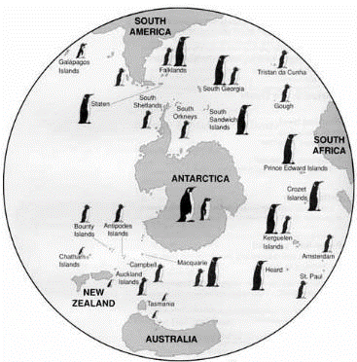
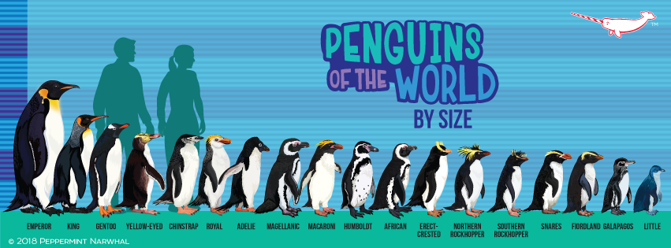
Penguins live in the Southern Hemisphere and come in 18 shapes and sizes
Illustration Credits: Peppermint Narwahl Creative Foundation (University of California „Where Penguins Live“ 1995)

Slide 7
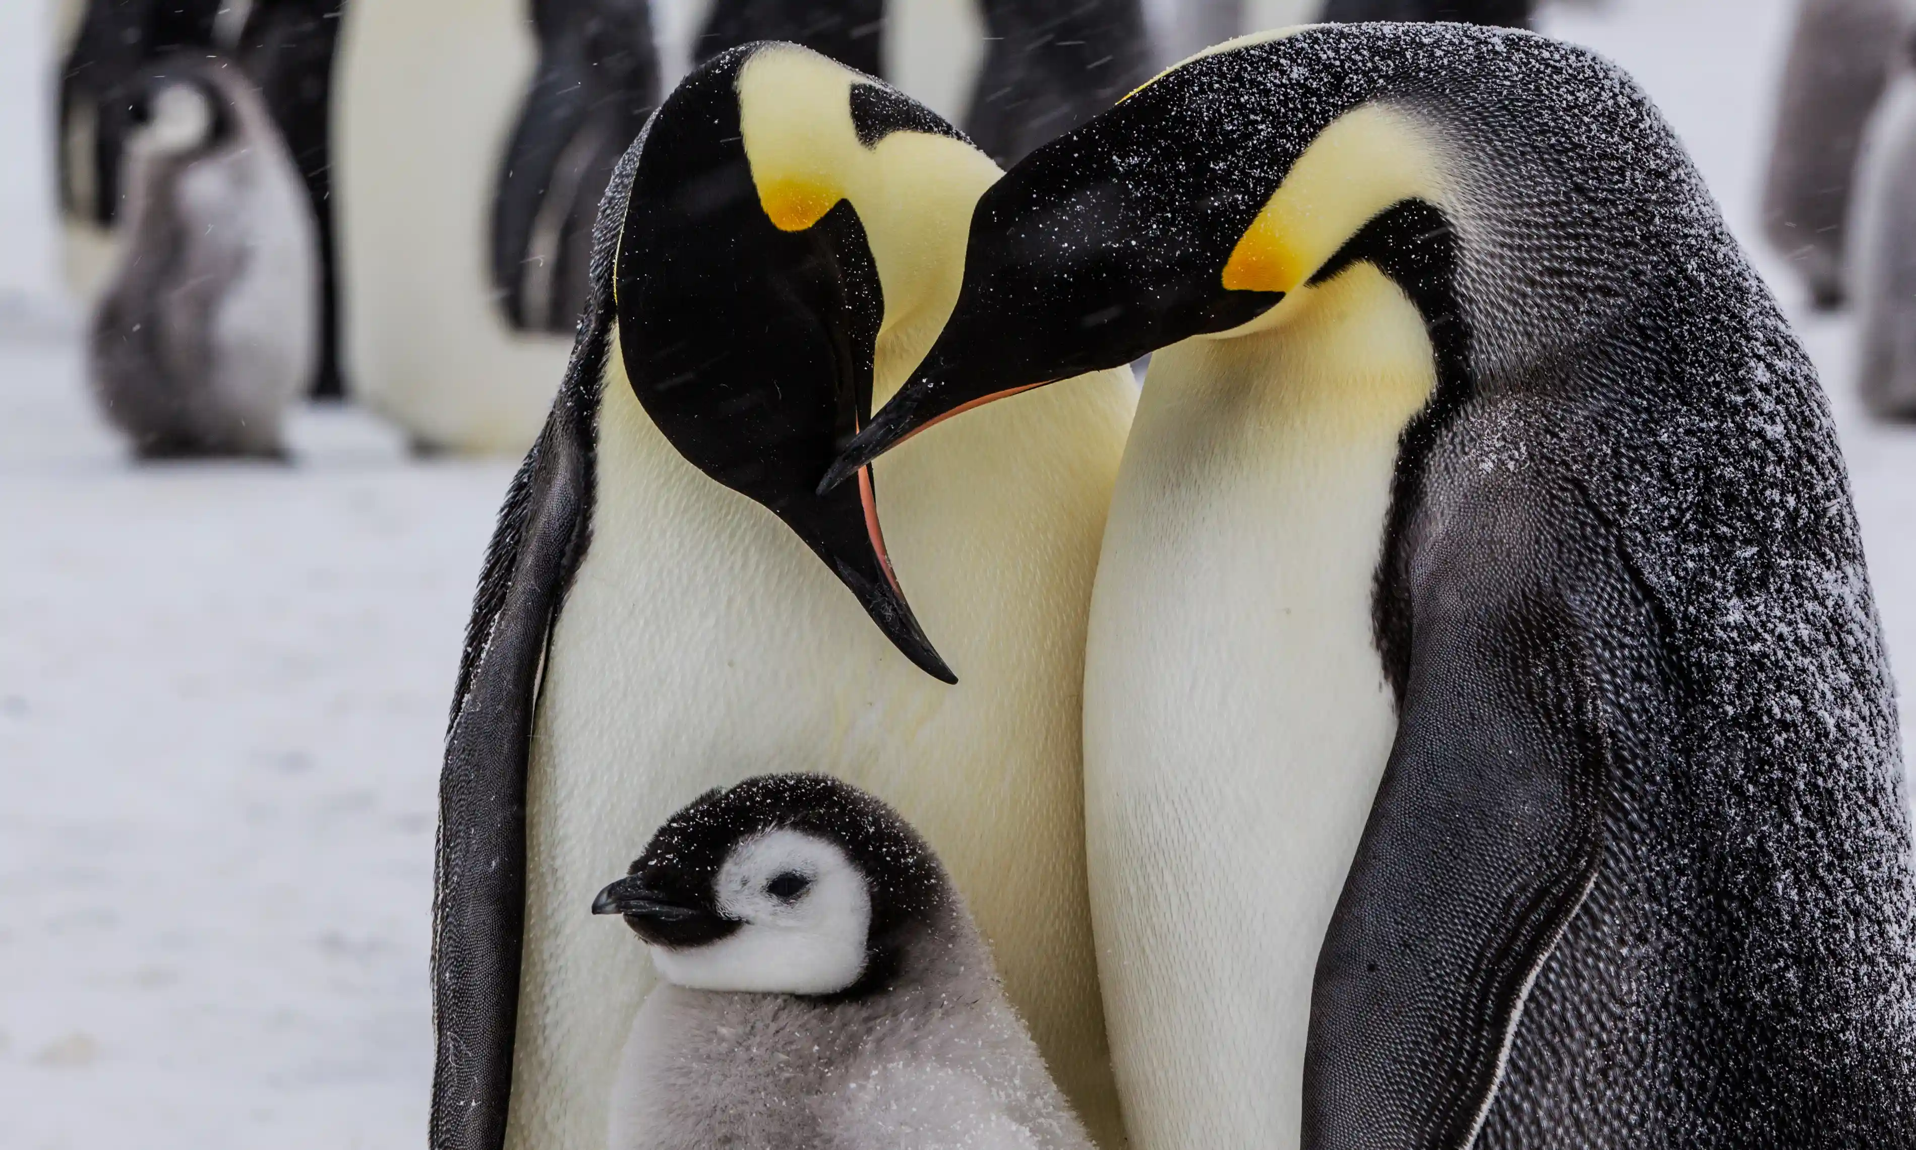
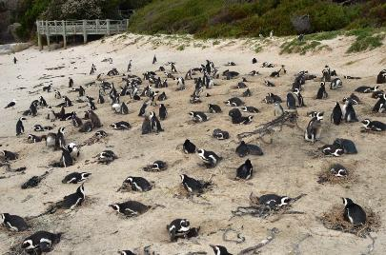
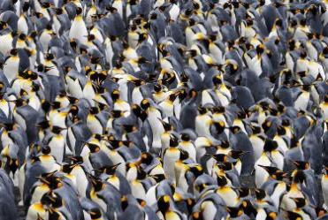
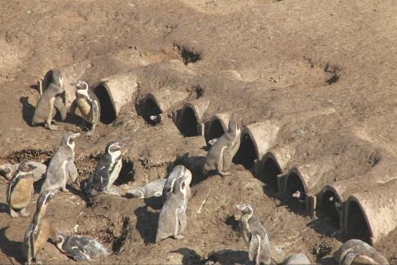
Penguins are not loners. They meet in large colonies of thousands at a time to nest
Penguins need to properly time when to migrate, nest, mate and seek food within seasonal limits to complete their life cycle – all while navigating a gamut of human-induced threats along the way.
African Penguin nesting (Photo: Kevin Graham)
King Penguin colony
Humboldt penguin artificial tunnel nests in Peru (cactus-lined lanscape) (Photo: Cardenas et al., 2012)

Slide 8
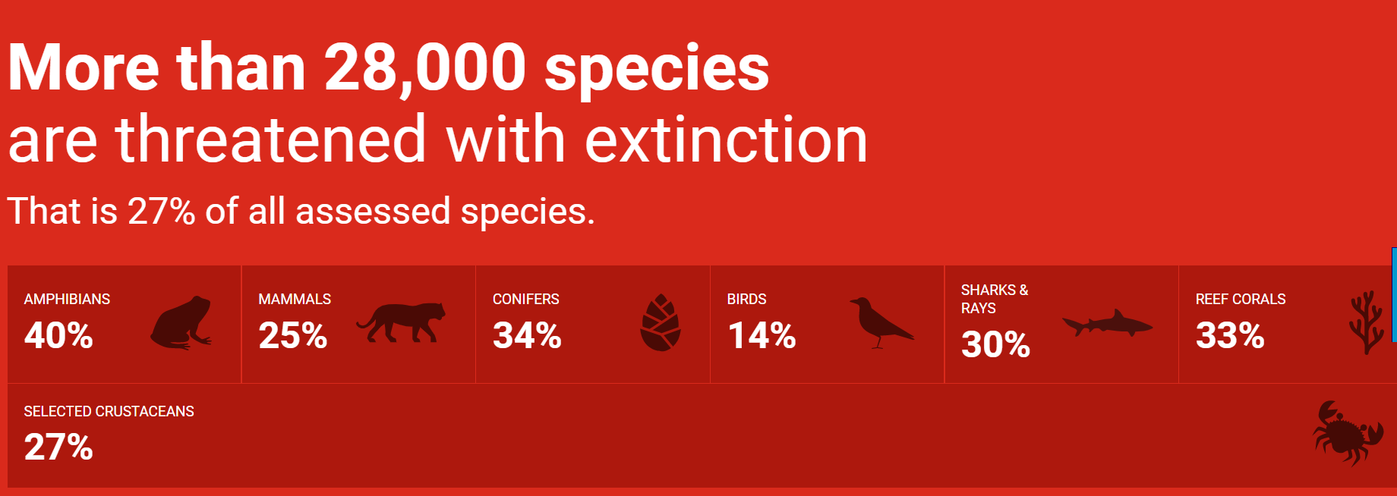
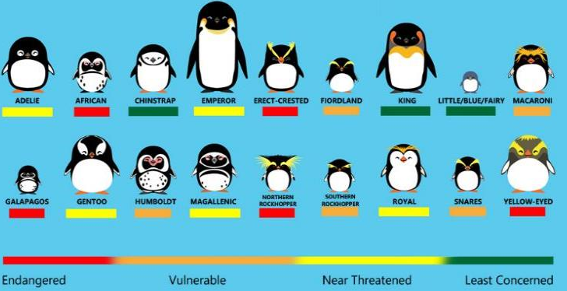
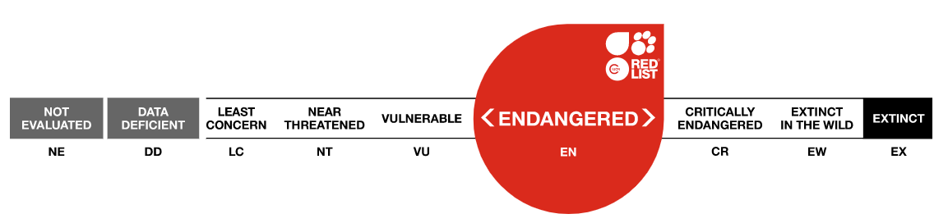
The IUCN Red list is our official barometer of life: 13 penguin species are listed in some category of threat with extinction

Slide 9
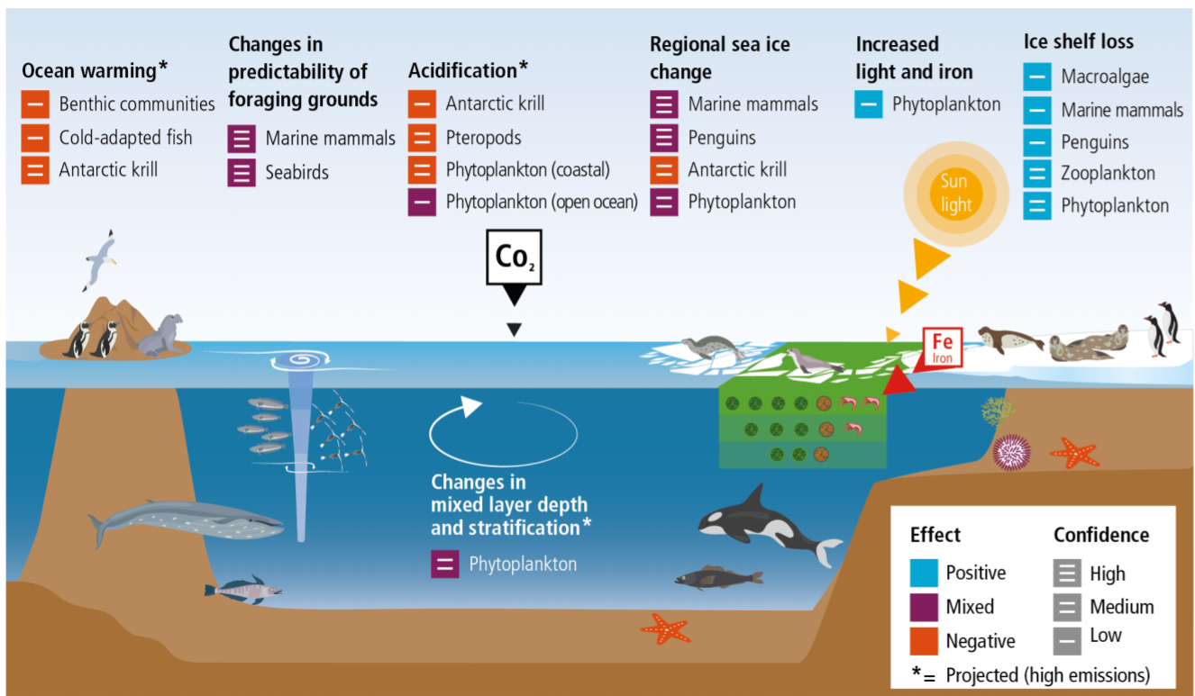
Human-induced threats
Climate variability and warming of seas
Overfishing, reduced food availability
Habitat degradation
Marine pollution (Plastics, Mercury)
Pathogens and disease
Toxic algal poisoning
Harvesting of adults for oil, skin, and feathers and as bait for crab
Harvesting of eggs (egging)
Penguins are top predators and flagship species for entire marine ecosystems
Citation: Special Report on the Ocean and Cryosphere in a Changing Climate. Chapter:3 Polar Regions. September 2019

Slide 10
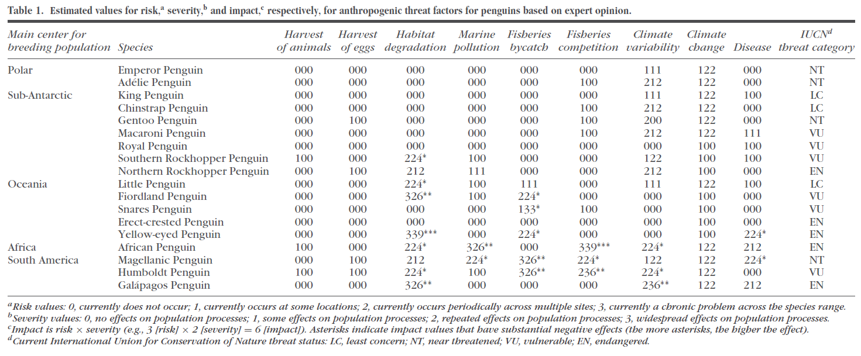
Not all human-induced threats are equal
Some pressures (such as climate change) can be indirect or cascade and are linked closely with other factors
Source: Trathan, Phil N., et al. "Pollution, habitat loss, fishing, and climate change as critical threats to penguins." Conservation Biology 29.1 (2015): 31-41.

Slide 11
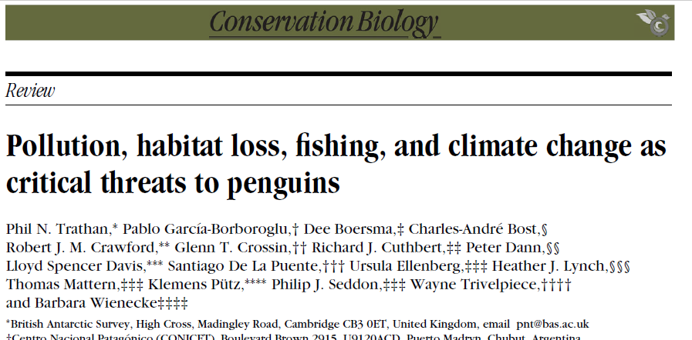
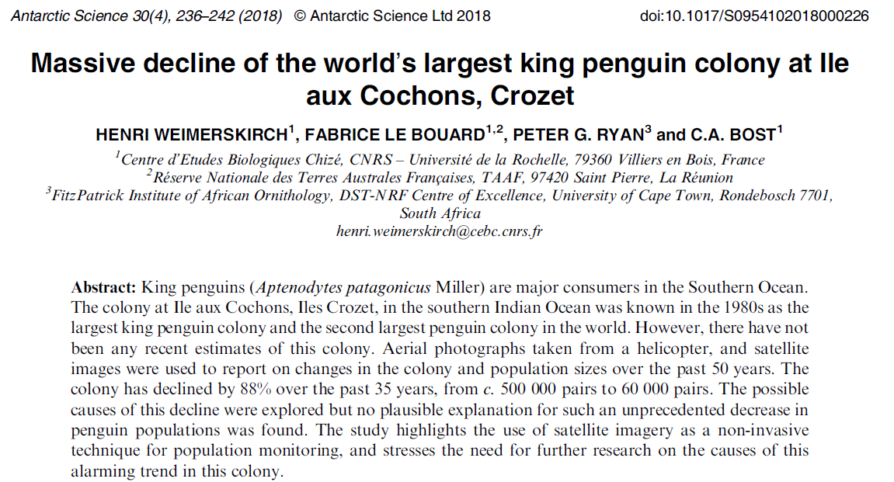
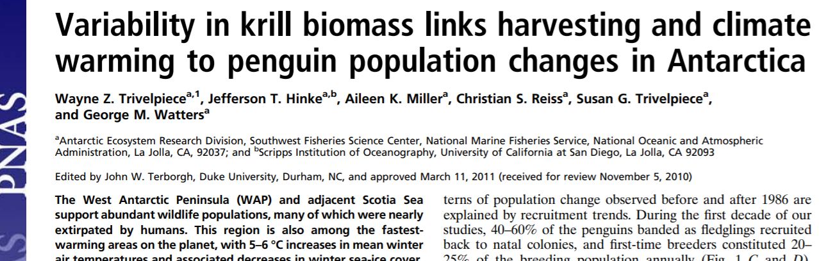
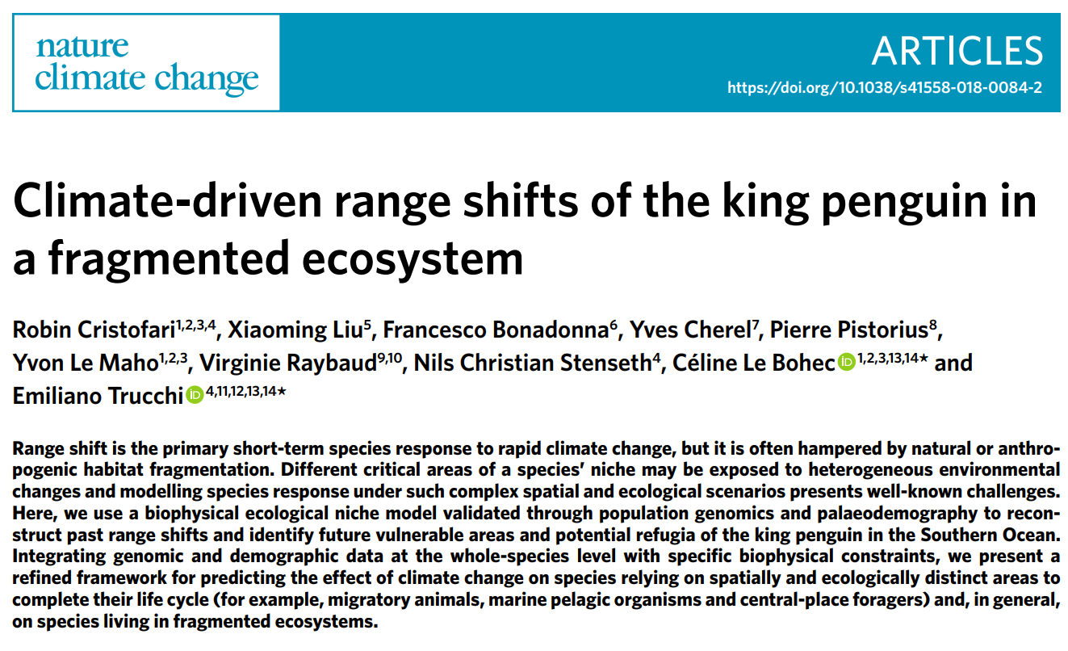
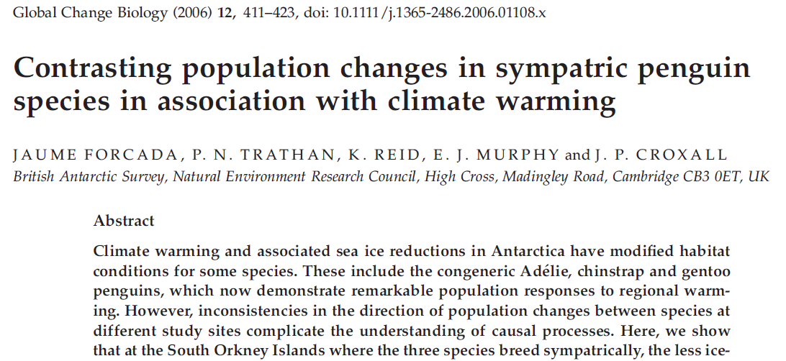
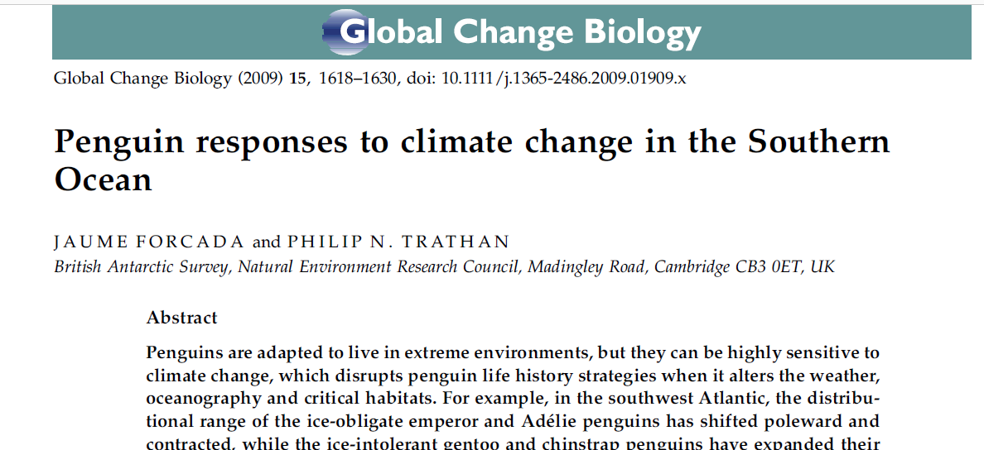
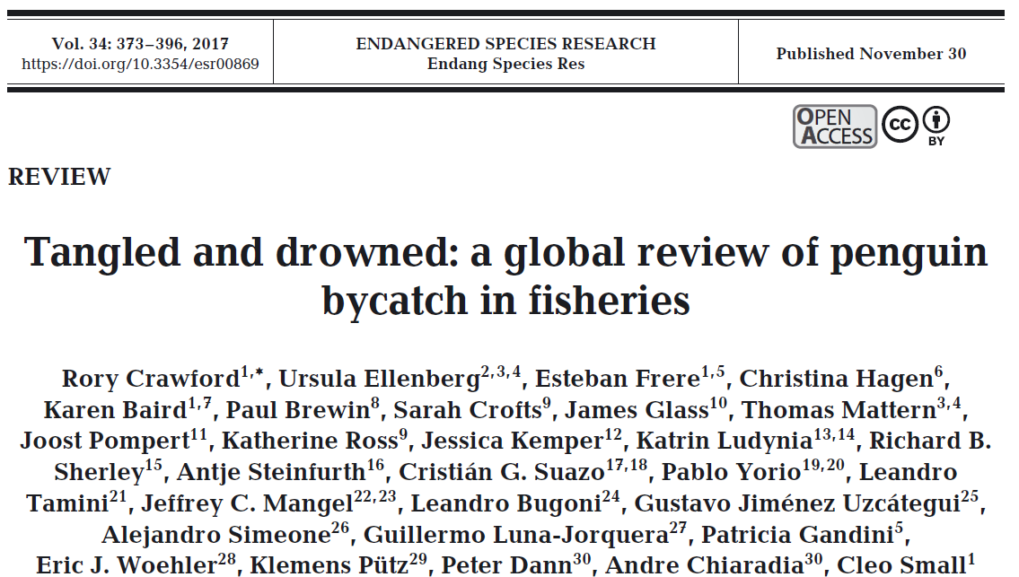
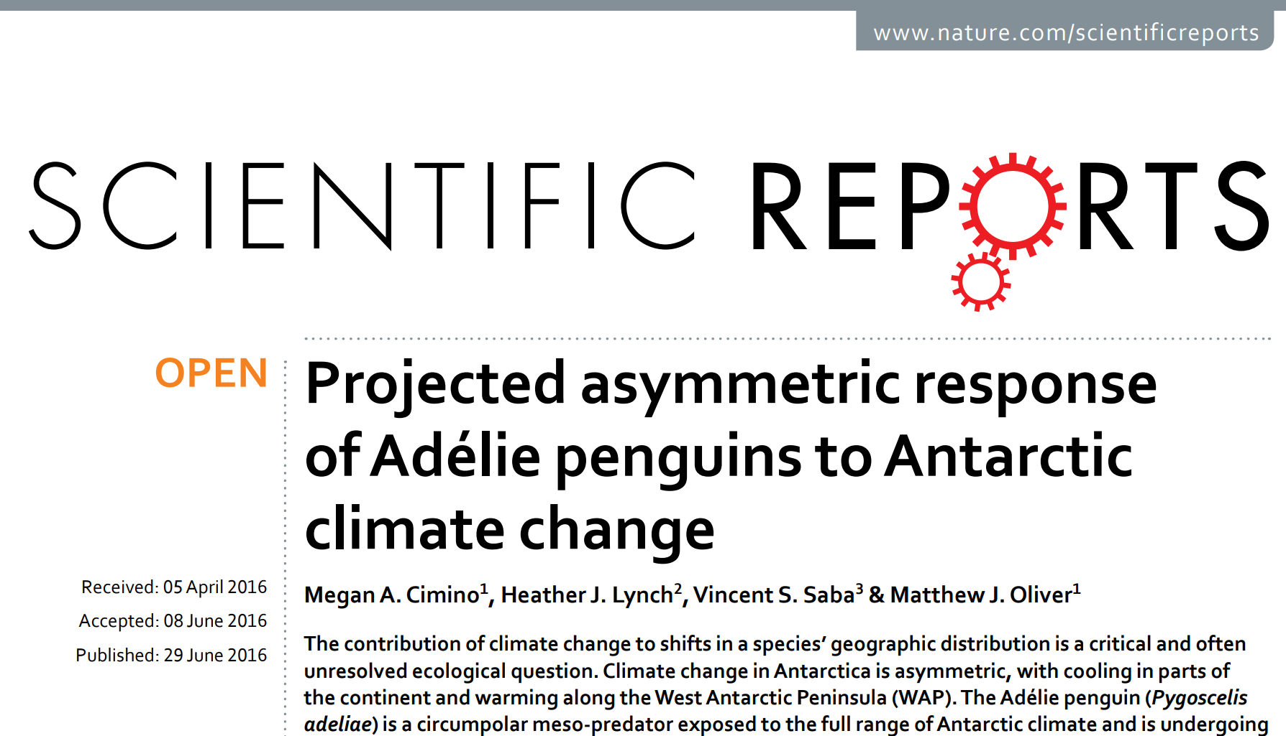
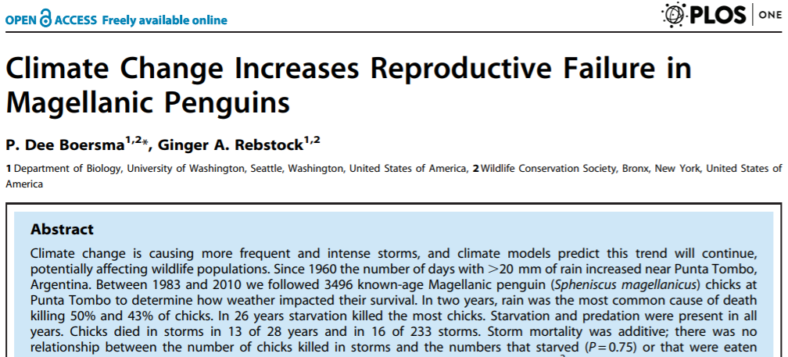
Research helps us disentangle the complex web of critical threats

Slide 12
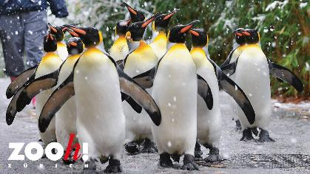

What roles does Zoo Zürich play to save the penguins?
A colony of 22 King Penguins are ambassdors to their counterparts in the sub-Antartic wild – they fascinated 1.2 million visitors last year
We collaborate with in-situ research and collaboration with Antarctic Research Trust (ART)
We partner with ART to better understand feeding and nesting distribution patterns in order to make evidence-based decisions for identifying critical grounds to protect or restore
GPS loggers are fitted to various species including rockhopper, Magellan penguins, King and Gentoo penguins to learn more about how far animals have to swim to forage

Slide 13
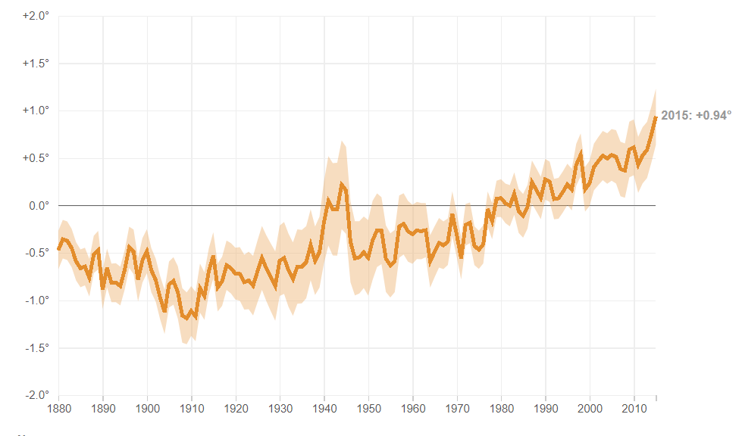
Threat: a warming climate
Warmer waters, heat waves, lead to climate-forcing shifts in foraging and nesting requirements:
King Penguins swim further to find sufficient prey (Cristofari, 2018)
Underfed Rockhopper adults returning from foraging grounds led to underfed chicks (Crawford et al., 2008)
Sea Surface Temperature Is Rising Globally
Ocean surface temperatures have risen each decade by 0.13°F on average since 1900. Source: EPA, Credit: Thomas Wilburn/NPR
Citations: RJM Crawford, AB Makhado, L Upfold & BM Dyer (2008) Mass on arrival of rockhopper penguins at Marion Island correlated with breeding success, African Journal of Marine Science, 30:1, 185-188, DOI: 10.2989/AJMS.2008.30.1.19.469
Cristofari, Robin, et al. "Climate-driven range shifts of the king penguin in a fragmented ecosystem." Nature Climate Change 8.3 (2018): 245.

Slide 14
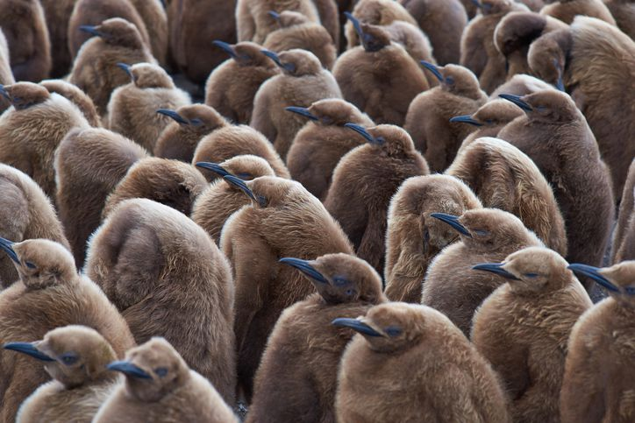
Threat: climate-variation: has a different impact on each species!
There is an inverse impact on population trends for Gentoo (increasing) vs. most other Antarctic-distributed penguin species (King penguins, Chinstrap, Adelie, King and Emperor) in response to climate variation. Special Report on the Ocean and Cryosphere in a Changing Climate. Chapter:3 Polar Regions. September 2019
Penguins need to balance change shifting ice conditions and a reduce prey availability
Storms and rain was the most common cause in the 50% of 3,500 Magellan penguin chicks followed for 25 years (Boersma et al., 2014)

Slide 15
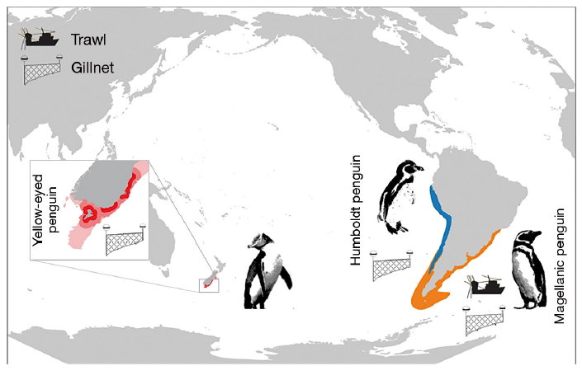
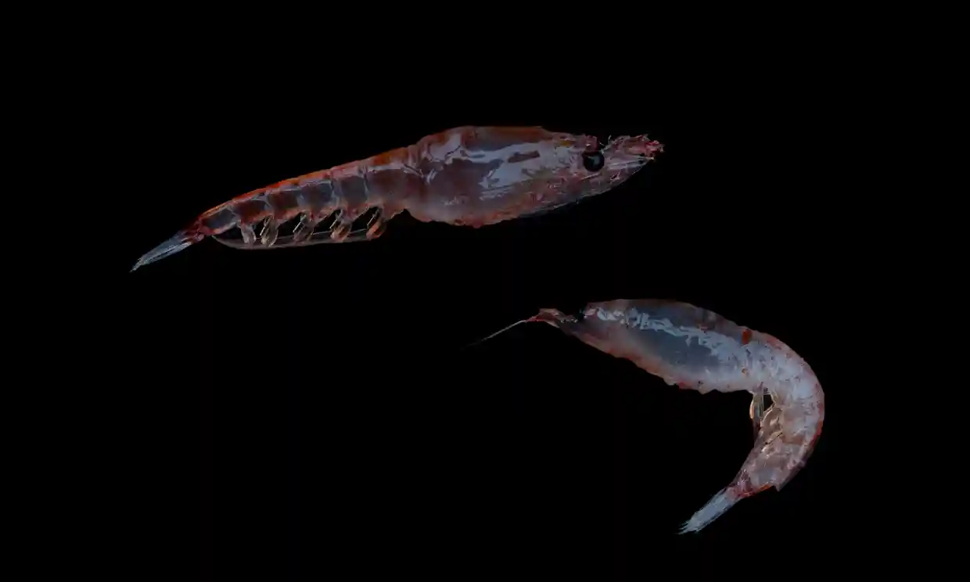
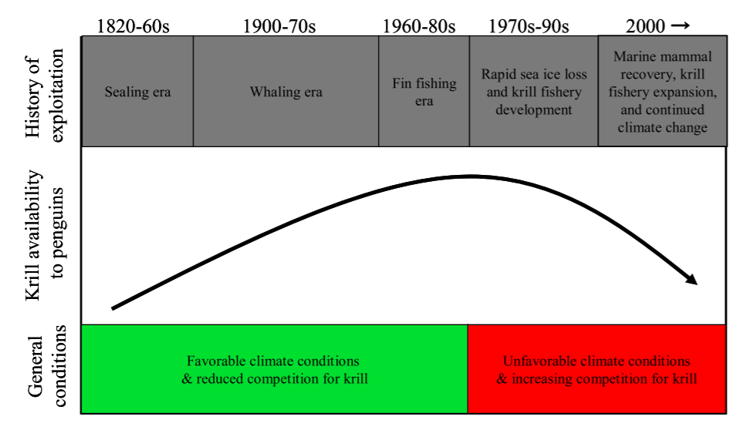
Threat: overfishing & harvesting
Ice-loving Adélie and ice-avoiding chinstrap penguins have declined significantly, likely due to prey abundance (Trivelpiece, et al., 2011)
Krill ( Euphausia superba) represent a critical component of the Antarctic food web. Photograph: Christian Åslund/Greenpeace
Source: https://www.theguardian.com/environment/2018/feb/14/decline-in-krill-threatens-antarctic-wildlife-from-whales-to-penguins
Schematic of ecosystem perturbances on Chinstrap and Adelie penguin populations (Trivelpiece et al., 2011)

Slide 16
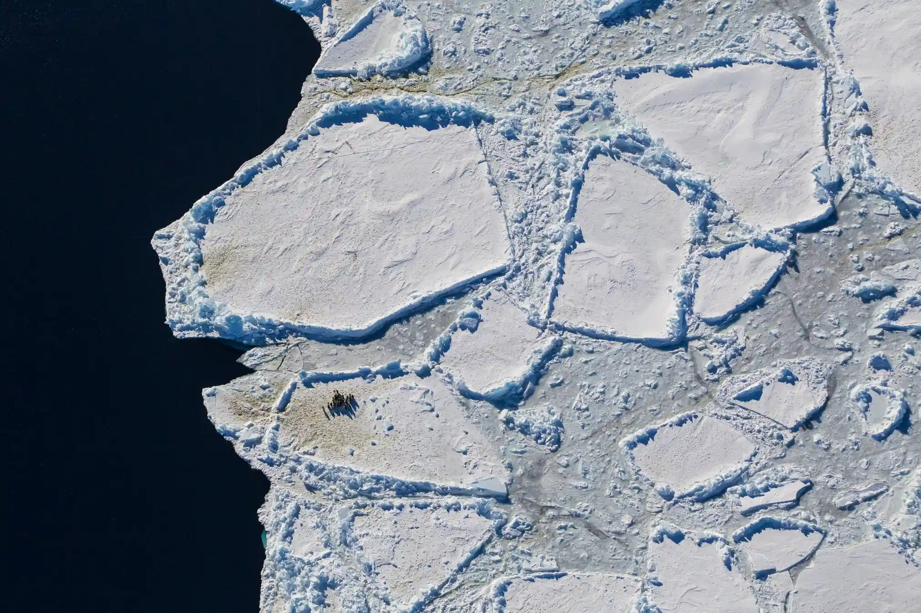
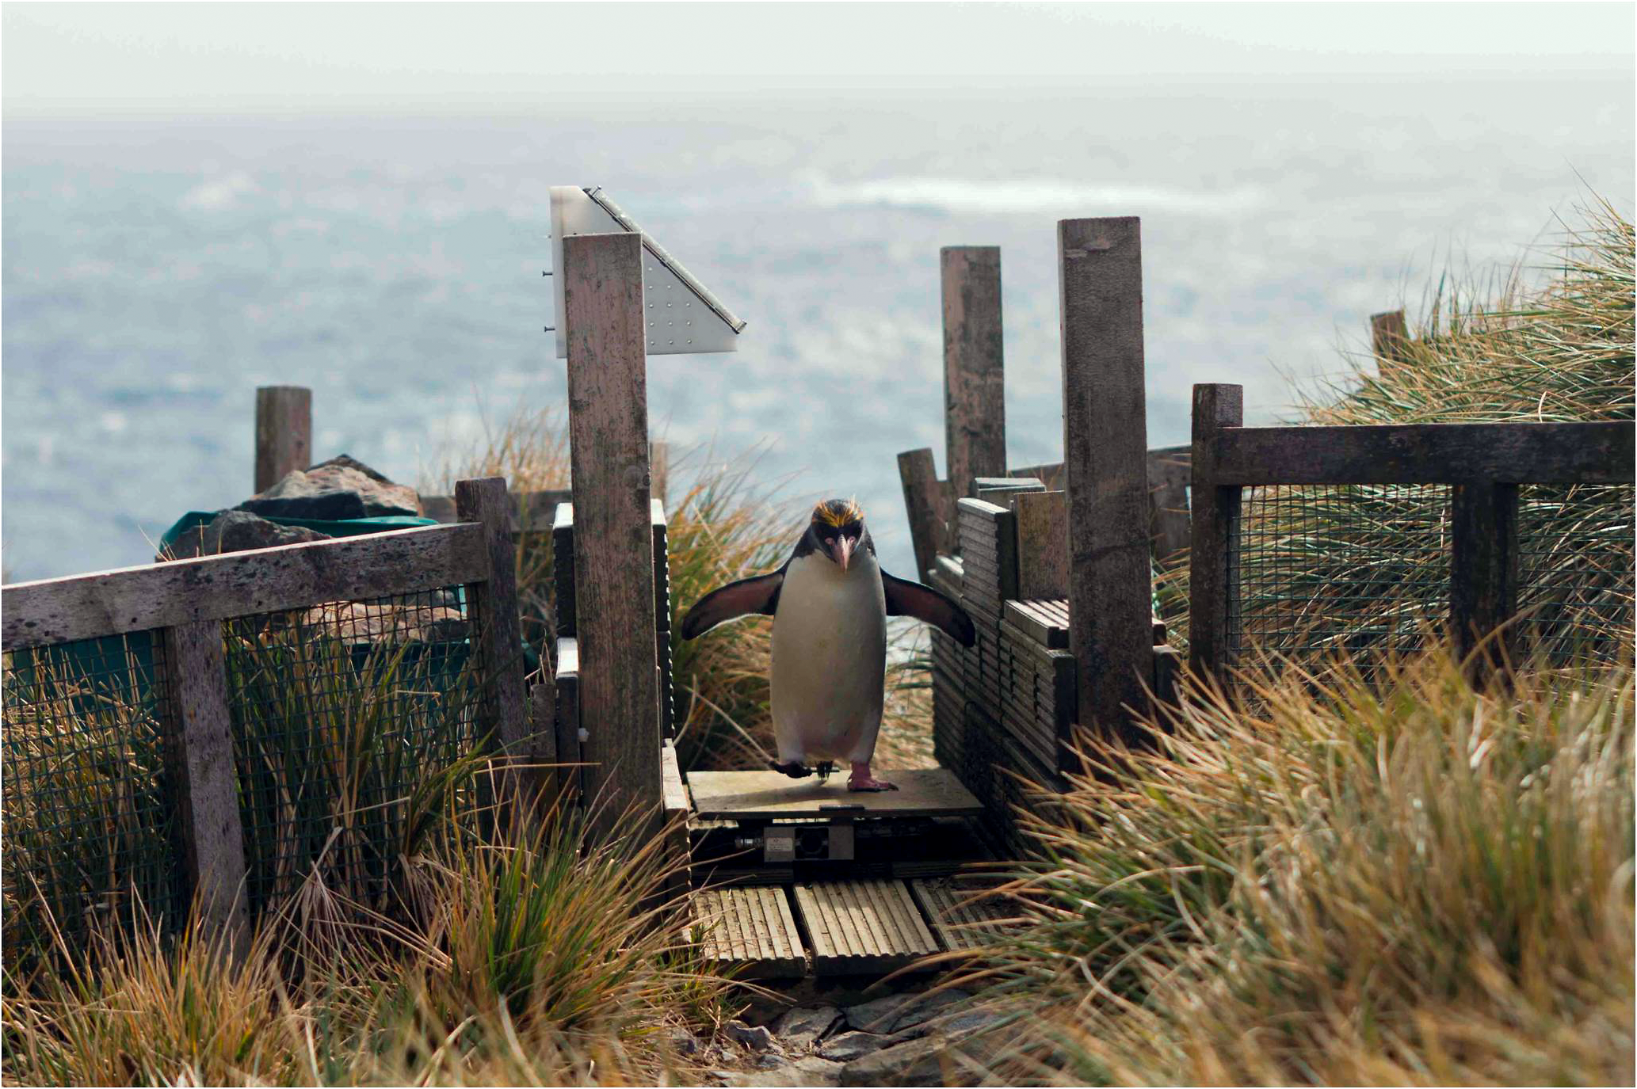
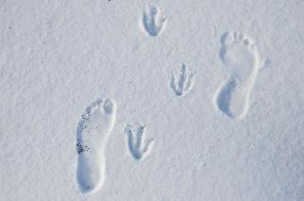
How will YOU help save the penguins from marching towards extinction?
Implementing tech (GPS, satellite imagery, RFIDs) informs interventions to prevent the plight of penguins
What creative ways can you come up with to reach out to others to raise awareness of our own footprint?
How can we make a difference to tackle reduction of habitat degradation, pollution, overfishing, and warming seas?

Slide 17
Program agenda
1
Situation of the penguins
2
Challenge in detail
3
Data sources
4
Oracle Labs Data Studio

Slide 18
Challenge in Detail
Your challenge
App
Zoo Visitor
My impact on planet
Interaction
Are you willing to change?
Model
My impact on penguins
Data
Awareness
Call to action

Slide 19
Challenge ideas
Interaction
Analyze user habits
Gamification
Source: Pixabay
Source: Pixabay
Based on data and facts
Source: Pixabay
Source: Pixabay
Source: Pixabay

Slide 20
Your Challenge
Think about how your solution relates to the Zoo Zurich.
Reach a million people and make them change!
Help save the penguins!

Slide 21
Program agenda
1
Situation of the penguins
2
Challenge in detail
3
Data sources
4
Oracle Labs Data Studio

Slide 22

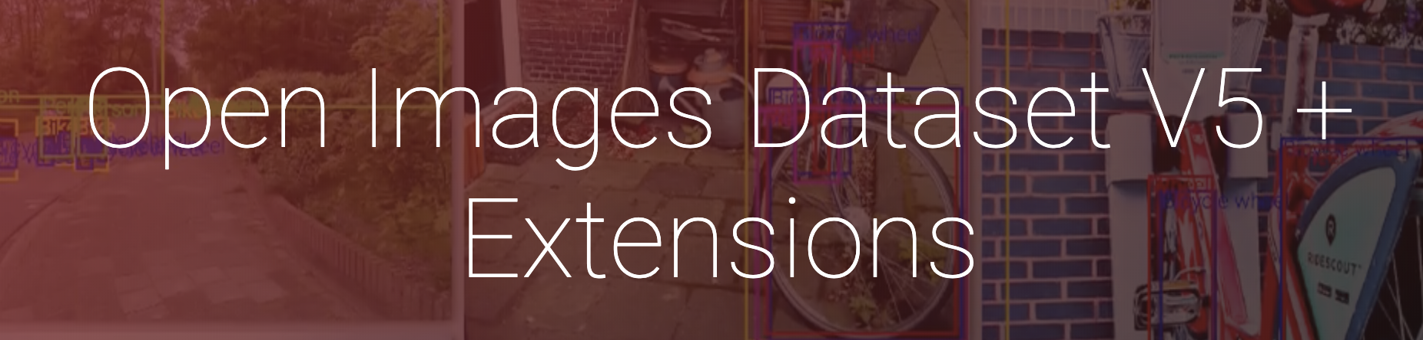

Potential Data Sources (1/2)
https://opendata.swiss/
https://storage.googleapis.com/openimages/web/index.html
https://ourworldindata.org
7018 Data Sets
9 million images
3028 Data Sets
Mobility and traffic
New car registration
Socio-demographic data
Types of food
Animals
Types of waste
Plastic Pollution
Global food production
Fossil fuel consumption

Slide 23
Potential Data Sources (2/2)
Pengiun GPS Data

Slide 24
Program agenda
1
Situation of the penguins
2
Challenge in detail
3
Data sources
4
Oracle Labs Data Studio

Slide 25
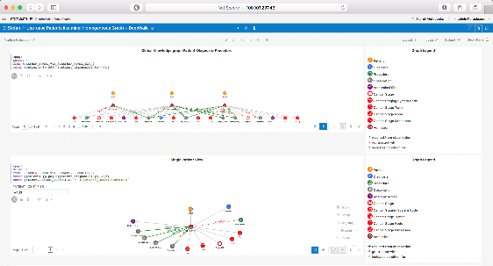
Oracle Labs Data Studio
Enterprise notebook technology
Web-based notebook platform for data scientists
Support live code collaboration in multiple programming languages (Python, Spark, MySQL,..)
Oracle Labs’s Products integration
DS comes packaged with Oracle Labs' graph analytics tool (PGX) and property graph query language (PGQL)
Interactive, Rich Visualizations
Display data in form of multiple charts, tables, graphs, texts, word cloud,..
Visual layer supports filtering graphs, highlighting elements, visualizing geographical data and more
Integration and usability of notebooks
REST API can be used to display notebooks, paragraphs, outputs, etc. outside of DS
Export notebooks in Iframe to embed paragraphs in external environments

Slide 26
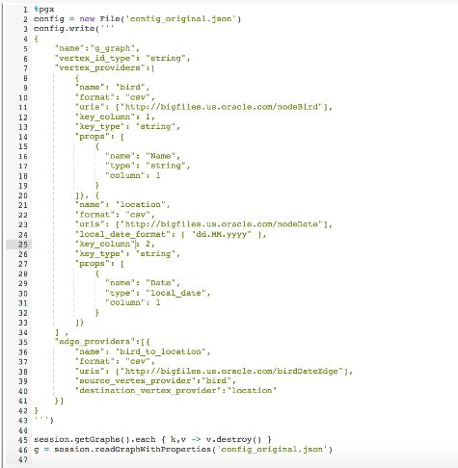
Oracle Parallel Graph AnalitiX (PGX)
Loading graphs into memory
Define Nodes, Edges and their properties when loading the graph into memory
Running built-in graph algorithms
35+ built-in graph analytics algorithms
DeepWalk, PageRank, WCC, Cycle detection, …
Running custom graph algorithms
Write up their own graph algorithms with the Green-Marl DSL and feed it to PGX
Running graph matching queries
Find sub-graphs of interest by querying a graph with Oracle Labs’s property graph query language (PGQL)

Slide 27
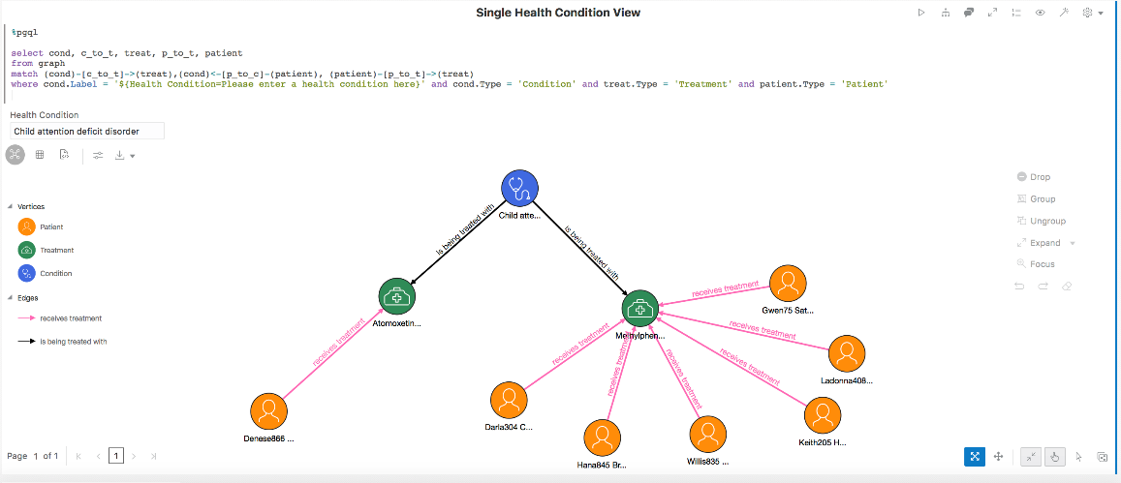
Oracle Parallel Graph Query Language (PGQL)
Return a “result set”
Edge -[…]->
Vertex (…)
Match graph pattern

Slide 28
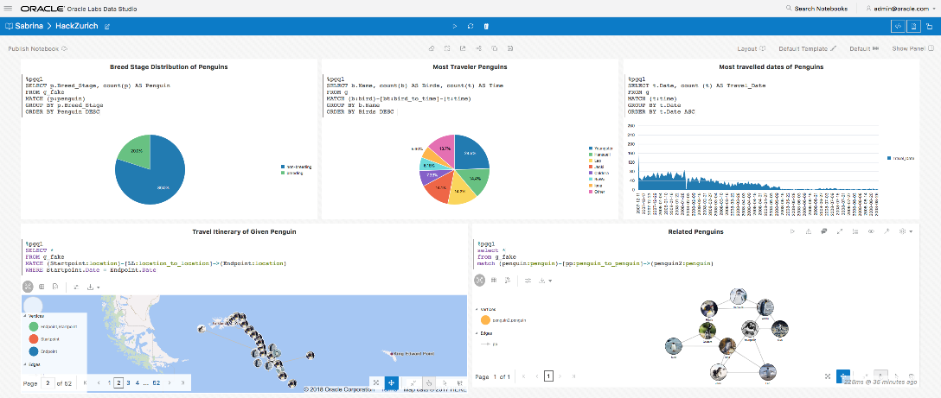
Sample Data Studio Notebook & Graphs
http://129.146.180.78:32678

Slide 29

Our support to you
Hands-on Sessions
There will be a couple of private hands-on sessions on using Data Studio and PGX for graph exploration during the Hackathon
Demo Sessions
We prepared demo notebooks and will be giving short demo sessions on them during the Hackathon
24/7 Support for technical questions
Our team will be available during the entire Hackathon to support you with any questions on DS and PGX
Booth challenge
Visit our booth to participate on the ?? challenge and have the chance to win a ??

Slide 30
Useful Links
PGX Documentation
https://docs.oracle.com/cd/E56133_01/latest/index.html
PGQL Documentation
http://pgql-lang.org/spec/1.2/#introduction
REST API Documentation
http://datastudio.oraclecorp.com/docs/apidoc/swagger-ui.html#/Notebooks
ZOO Zurich Research
https://www.zoo.ch/de/naturschutz-tiere/naturschutzprojekte/antarctic-research
Oracle Labs
https://labs.oracle.com/pls/apex/f?p=LABS:10::::::

Slide 31











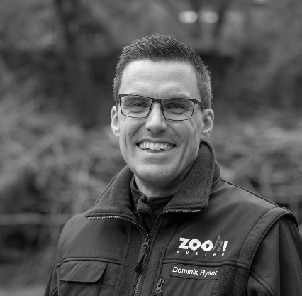
The HackZurich Team

